Slide 1

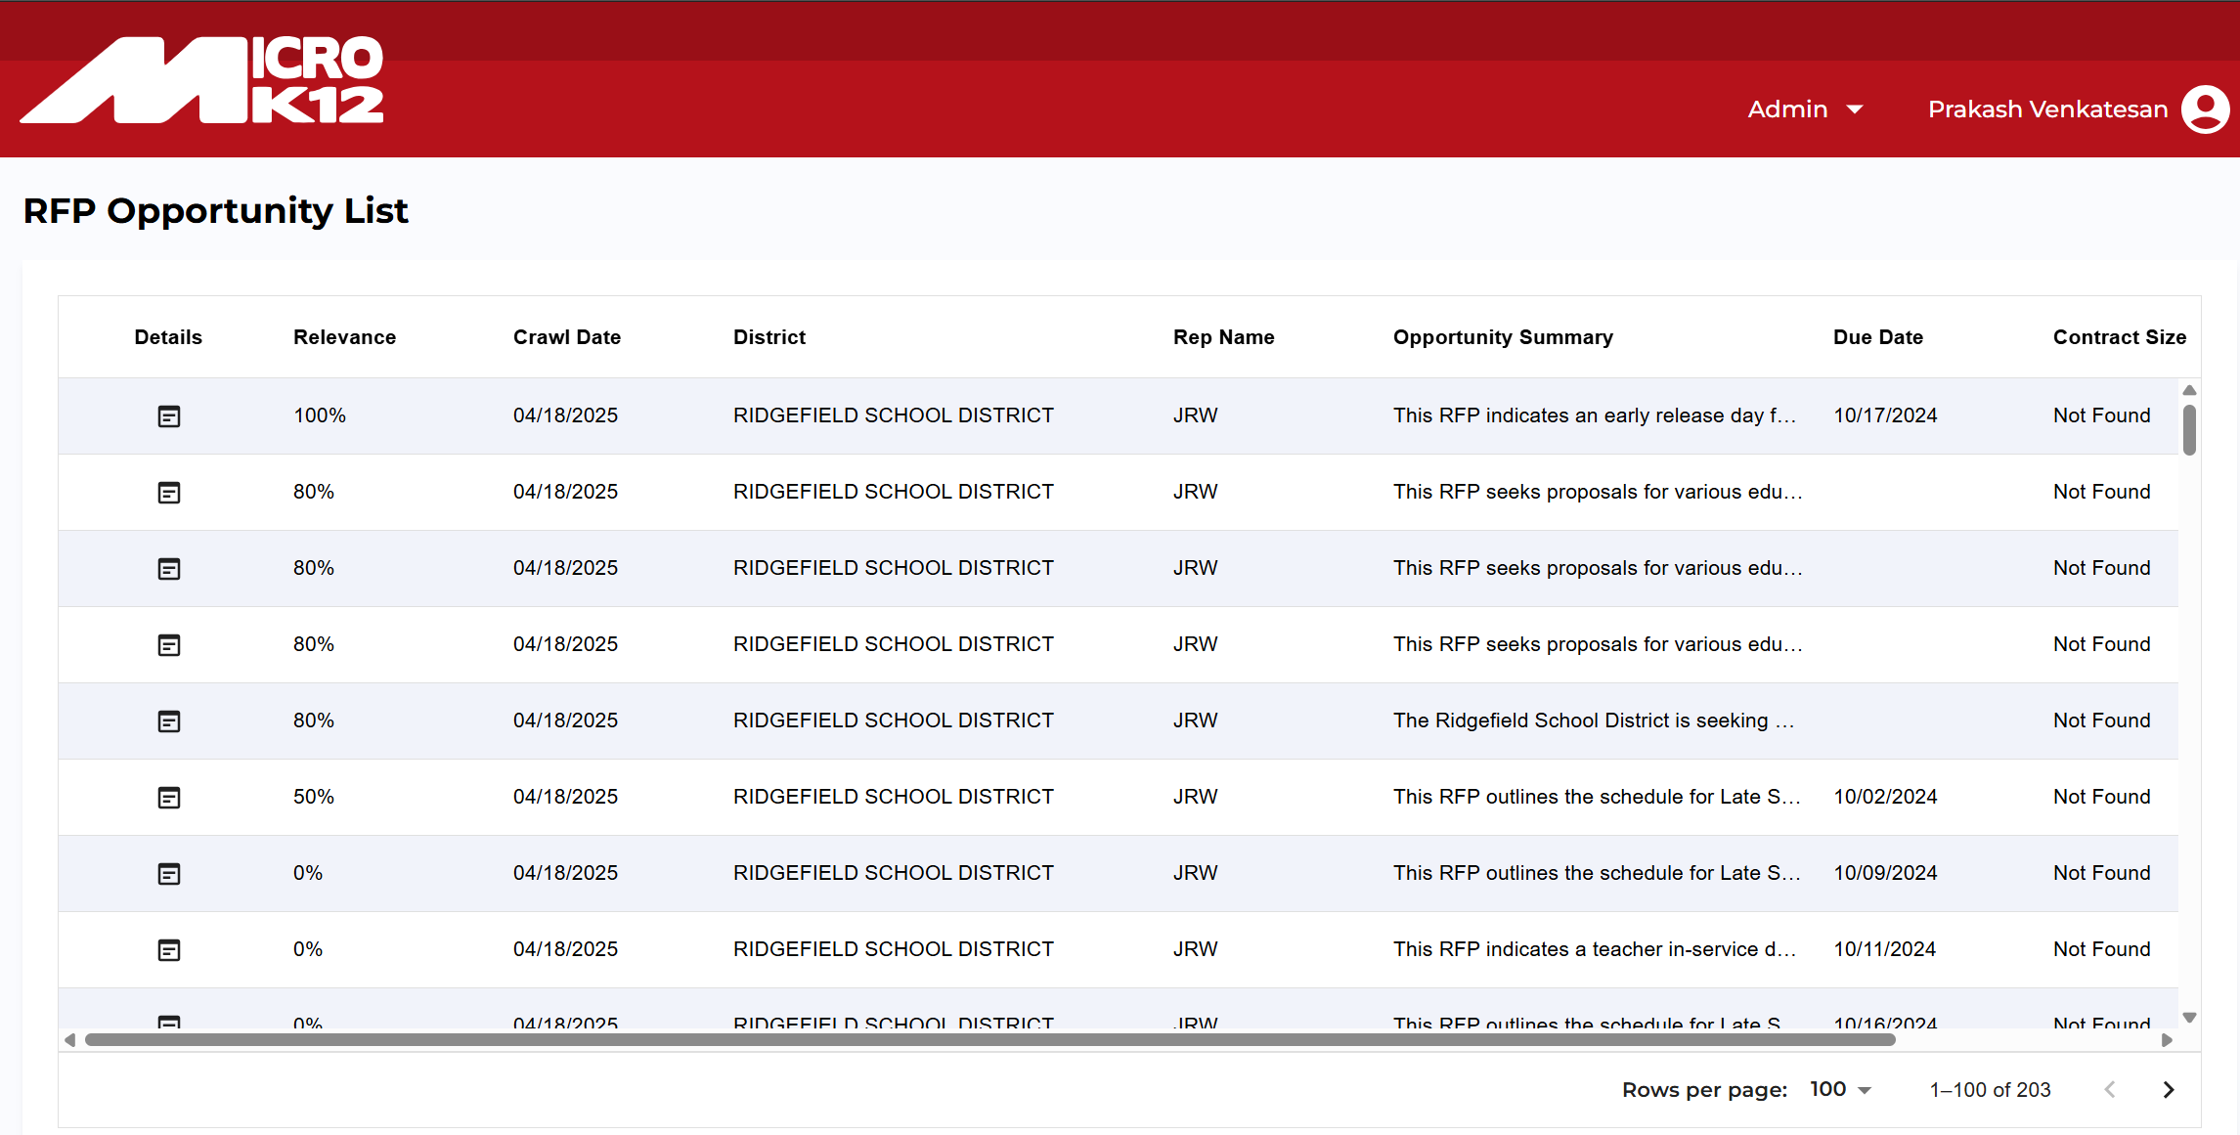
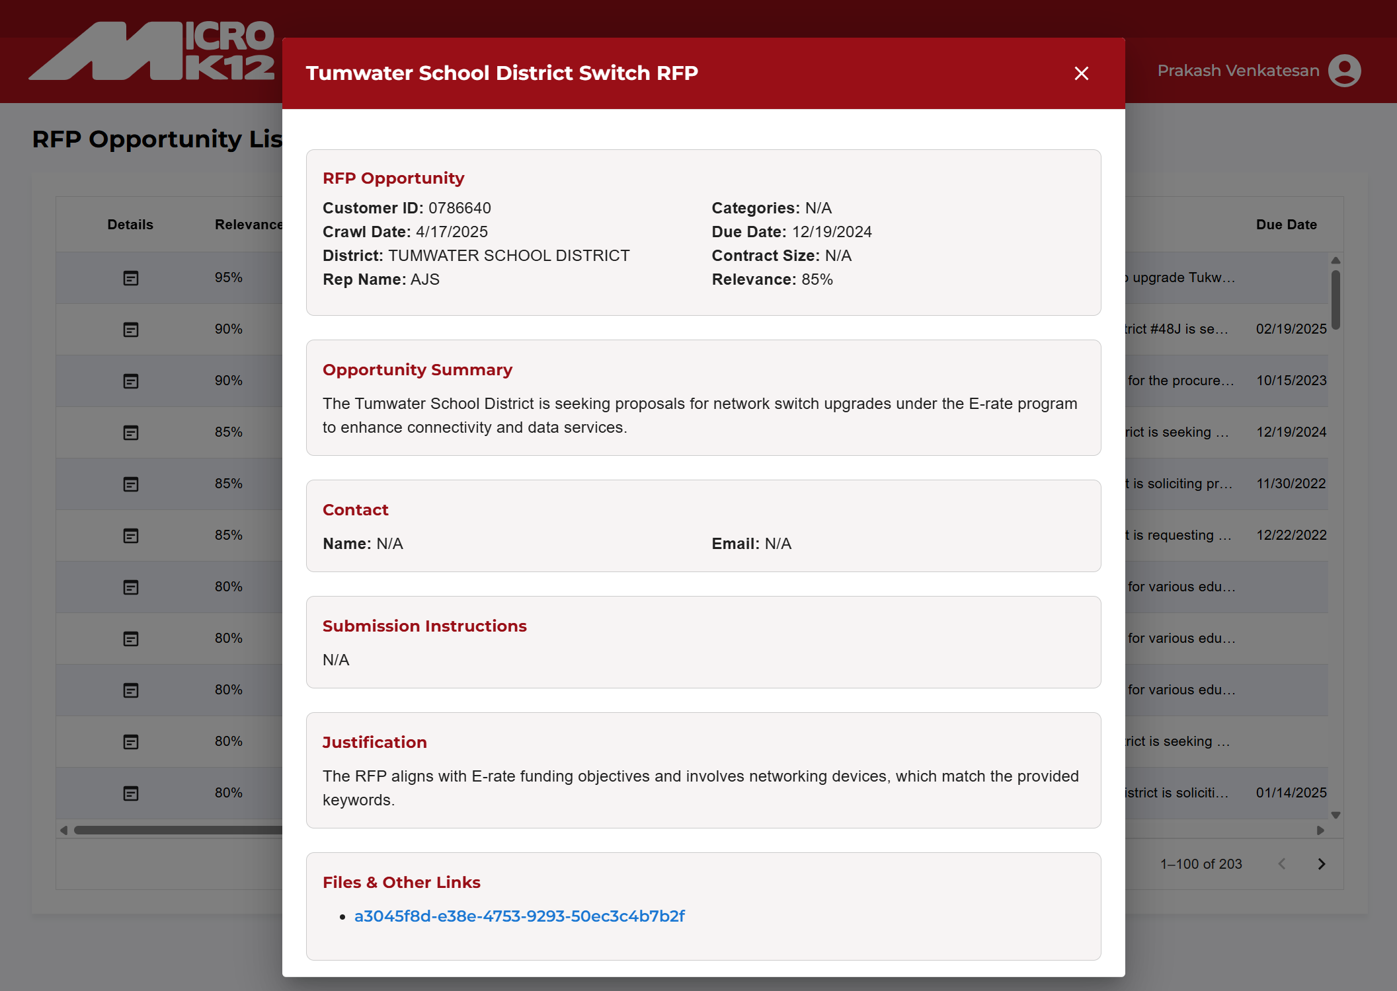
MicroK12 – AI Sales Automation
Business Need
MicroK12’s sales team spent significant time manually reviewing school district websites for new RFPs. To improve efficiency, they engaged Affirma to build a Copilot-driven solution that automates RFP discovery, analysis, and routing to the sales team.
What we Did
Affirma built an AI-driven web crawler to scan school district websites and extract RFPs aligned with MicroK12’s offerings. Using CoPilot and Azure OpenAI, the system evaluates each RFP’s relevance, enabling smarter targeting and quicker decisions.
Connected Copilot to a custom crawler that scans school district sites for new RFPs
Used Copilot and Azure OpenAI to evaluate relevance based on MicroK12’s offerings
Extracted key details such as district, due date, value, contacts, and relevance score
Built a simple web app for reviewing opportunities and managing crawl schedules
Integrated with HubSpot for automated opportunity creation and reporting
Outcomes
50 percent faster RFP identification and review
More relevant opportunities surfaced through Copilot-powered filtering
Centralized workflow that streamlines how sales teams act on new opportunities

Slide 2
MicroK12 – AI Sales Automation
Business Need
To identify new RFPs, MicroK12's sales team manually reviews hundreds of school district websites—a time-consuming process that limits efficiency and scalability.
To solve this, MicroK12 engaged Affirma to explore an AI-powered solution that automates RFP discovery and analysis, reducing manual effort and enabling faster, more strategic sales outreach.
What we Did
Affirma built an AI-driven web crawler to scan school district websites and extract RFPs aligned with MicroK12’s offerings. Using Azure OpenAI, the system evaluates each RFP’s relevance, enabling smarter targeting and quicker decisions.
Open4AI Crawler: Crawls school district websites automatically and extracts open RFP details
AI-Powered Data Processing: Using Azure OpenAI and ChatGPT models to scan the RFP details using MicroK12’s competency and offerings data to find the relevant RFP that could benefit MicroK12.
Extract RFP Details: RFP details like School District, RFP Due Date, Contract Value, Contact Details & AI calculated Relevancy score
Custom Web App: Built a Custom web app for MicroK12’s sales team to review the AI identified opportunities and decisioning. Also gives ability to manage School District, URLs to crawl and the schedule.
HubSpot Integration: Push RFQs and SO details into HubSpot for larger sales team reporting
Outcomes
50% faster RFP response time through automated discovery and AI filtering
Increased opportunity relevance with AI-matched RFPs aligned to MicroK12’s strengths
Streamlined sales workflow via a centralized platform for opportunity review and management

Slide 3
MicroK12 – AI Powered Sales Automation
Business Need
MicroK12 is a leading K–12 education technology provider with over 40 years of experience, offering devices, networking equipment, interactive displays, and managed IT services. Partnering with top brands like Google, Microsoft, and HP, they support schools in deploying modern, tech-enabled classrooms and 1:1 student device programs.
To identify new RFPs, MicroK12's sales team manually reviews hundreds of school district websites—a time-consuming process that limits efficiency and scalability.
To solve this, MicroK12 engaged Affirma to explore an AI-powered solution that automates RFP discovery and analysis, reducing manual effort and enabling faster, more strategic sales outreach.
What We Did
Affirma built an AI-driven web crawler to scan school district websites and extract RFPs aligned with MicroK12’s offerings. Using Azure OpenAI, the system evaluates each RFP’s relevance, enabling smarter targeting and quicker decisions.
Open4AI Crawler: Crawls school district websites automatically and extracts open RFP details
AI-Powered Data Processing: Using Azure OpenAI and ChatGPT models to scan the RFP details using MicroK12’s competency and offerings data to find the relevant RFP that could benefit MicroK12.
Extract RFP Details: RFP details like School District, RFP Due Date, Contract Value, Contact Details & AI calculated Relevancy score
Custom Web App: Built a Custom web app for MicroK12’s sales team to review the AI identified opportunities and decisioning. Also gives ability to manage School District, URLs to crawl and the schedule.
Results
50% faster RFP response time through automated discovery and AI filtering
Increased opportunity relevance with AI-matched RFPs aligned to MicroK12’s strengths
Streamlined sales workflow via a centralized platform for opportunity review and management

